Slide 1
Neurodiversity and Independent Living
Florian Sanden

Slide 2
Who am I, why am I giving this presentation?
Functions:
Policy Coordinator at European Network on Independent Living – ENIL (Disability rights NGO)
Board member of ND Belgium
Member of WHO Technical Advisory Group on Healthcare of persons with disabilities
Advisory board of Interest Representation Independent Living Germany (disability rights NGO)
Volunteer with the European Council of Autistic People
Individual member of Associação Portuguesa Voz do Autista
Individual member of the German Society of Bipolars Disorders

Slide 3
Who am I, why am I giving this presentation?
I identify as neurodivergent and I am diagnosed as autistic and bipolar
I identify and I am recognised as disabled (in Belgium and Germany)
I am an activist for disability rights and an ND self-representative
Convinced of the need to have strong cooperation between the Independent Living Movement and the Neurodiversity Movement
Story of a relationship that is not always easy...

Slide 4
A mixed relationship
Many ND people and ND organisations in the Independent Living Movement
European Council of Autistic People
Many questions and miss understandings
Physically impaired find it hard to imagine what being ND is like
Many ND people reject the disability perspective
Possible reasons
View disability as stigma
Equate being disabled with being incurably sick
Lack of understanding of human rights and social models of disability

Slide 5
I hope to shed light on:
What are the human rights and the social model of disability
A philosophy not of stigma but of liberation!!
How the Independent Living approach holds the key for better lives for ND people
Why does it make sense to get organised?

Slide 6
Can neurodiverse people participate equally in society? Do we have the same opportunities?

Slide 7
Do you feel you have
Help with your personal support needs?
Getting out of bed, taking care of personal hygiene, doing administrative tasks, doing groceries, cleaning the house, participating in free time activities?
Equal access to work?
Have you lost your work because of you being ND? Do you know someone who did?
Being paid less because you are ND?
Been forced into sheltered employment?
Equal access to education?
You know someone who had to drop out of school?
Had to go through special education, is left without a degree?
Has to live in a residential setting where one´s rights are violated?

Slide 8
I know neurodiverse people who are...
Left alone with strong support needs
Lost their job because of discrimination
Are pushed into sheltered workshops
Struggled to get through mainstream education or failed
Are against their will institutionalised in psychiatric hospitals or group homes or because it’s the only choice
Are discriminated against in accessing healthcare
Are isolated
Are victims of police violence
Don´t have access to accessible free time activities
…..

Slide 9
Conclusion
We are surrounded by barriers erected by society!

Slide 10
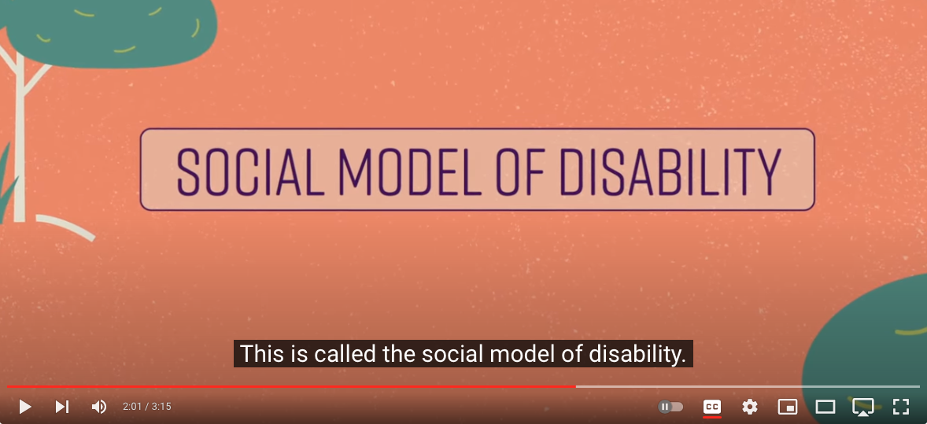
“In our view, it is society which disables physically impaired people. Disability is something imposed on top of our impairments, by the way we are unnecessarily isolated and excluded from full participation in society. Disabled people are therefore an oppressed group in society”
(The Union of the Physically Impaired Against Segregation 1975)

Slide 11
From stigma to a philosohpy of liberation
“In our view, it is society which disables physically impaired people. Disability is something imposed on top of our impairments, by the way we are unnecessarily isolated and excluded from full participation in society. Disabled people are therefore an oppressed group in society”
(The Union of the Physically Impaired Against Segregation 1975)
It is not you who is wrong, it is society!
From disagreeing with society to changing society
Dismantle the barriers!
End our oppression!
Give us freedom!

Slide 12
Disability is not only physical
United Nations Convention on the Rights of Persons with Disabilities (2006)
Persons with disabilities include those who have long-term physical, mental, intellectual or sensory impairments which in interaction with various barriers may hinder their full and effective participation in society on an equal basis with others.

Slide 13
How do neurodiversity and disability relate?
Up to you....
For me: Neurodiversity + societal barriers = Disability

Slide 14
Do we have to life as un-equals?
How can we be free?

Slide 15
Definition of Independent Living
“IL is having the same range of options and same degree of self-determination that people without a disability take for granted.” (A. Ratzka)
Choice and control
Access to support in the community and to mainstream services

Slide 16
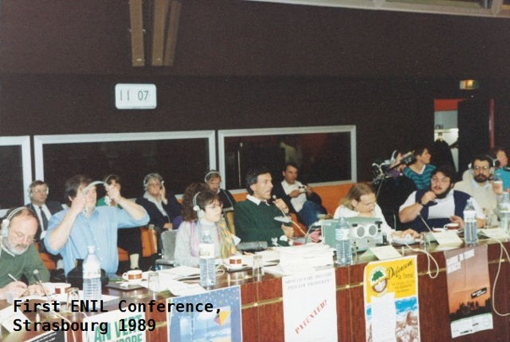
Strasbourg Resolutions
“Since we are often considered sick, many of us get shut away in hospitals and hospital-like institutions. There, it is claimed, we can be better “cared for”. With this argument we are put into special kindergartens, special schools, special workshops, special housing, special transportation. The only places that are still not segregated are the cemeteries! We have to shut down these special, dehumanising and degrading Apartheid solutions and force our way into the mainstream of society”
Adolf Ratzka, ‘89

Slide 17
From recognising to tackling the barriers!
The Independent Living philosophy demands:
You can live where you want, with the support and services you want
You get the accommodations you need
You get the materials you need
Same educational qualifications as others
Same jobs and wages as others

Slide 18
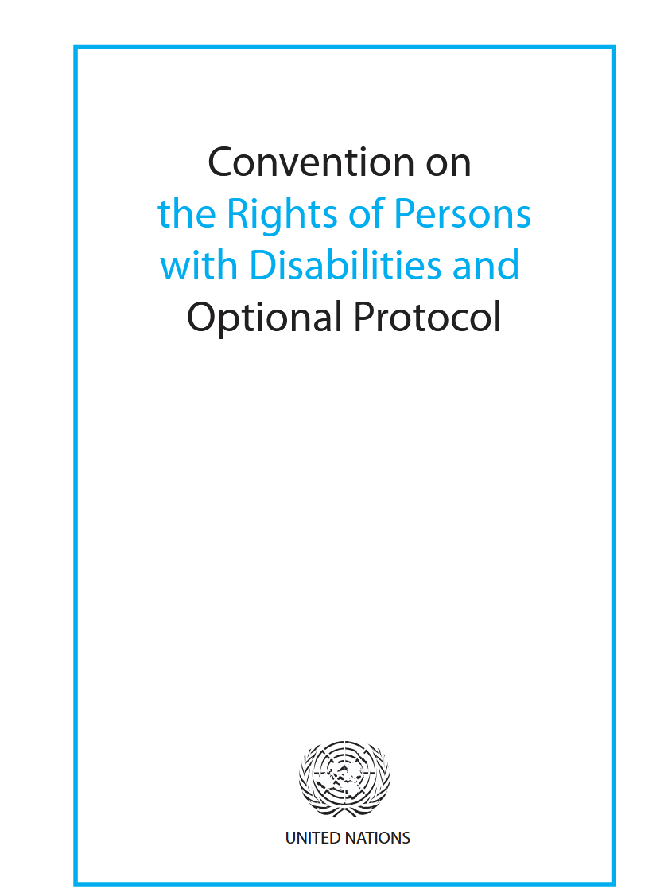
It is your goddam right!
UN Convention on the Rights of Persons with Disabilities
Ratified by all EU countries!
Part of primary law

Slide 19
It is your goddam right!
UN Convention on the Rights of Persons with Disabilities
Right to have a life on a basis equal to others
Right to personalised support
Personal assistance
Right to employment on basis equal to others
Right to education on an equal basis to others

Slide 20
How to get your rights in practice?
Get organised!
Example of a disability rights organisation
European Network on Independent Living - ENIL

Slide 21
How to for the rights of disabled people
Policy and advocacy
Protest
Legal action
Research
Awareness raising
Empowerment

Slide 22
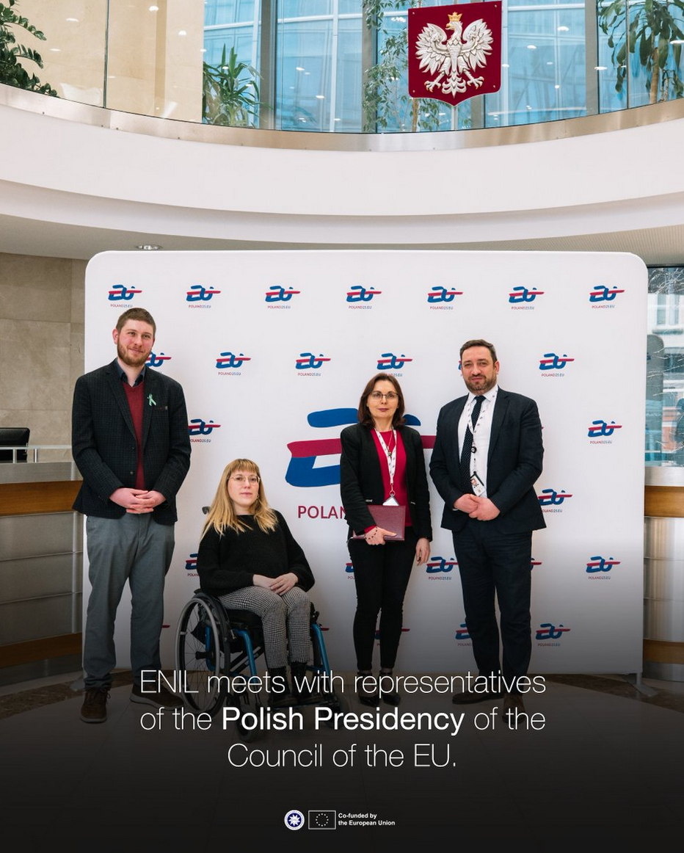
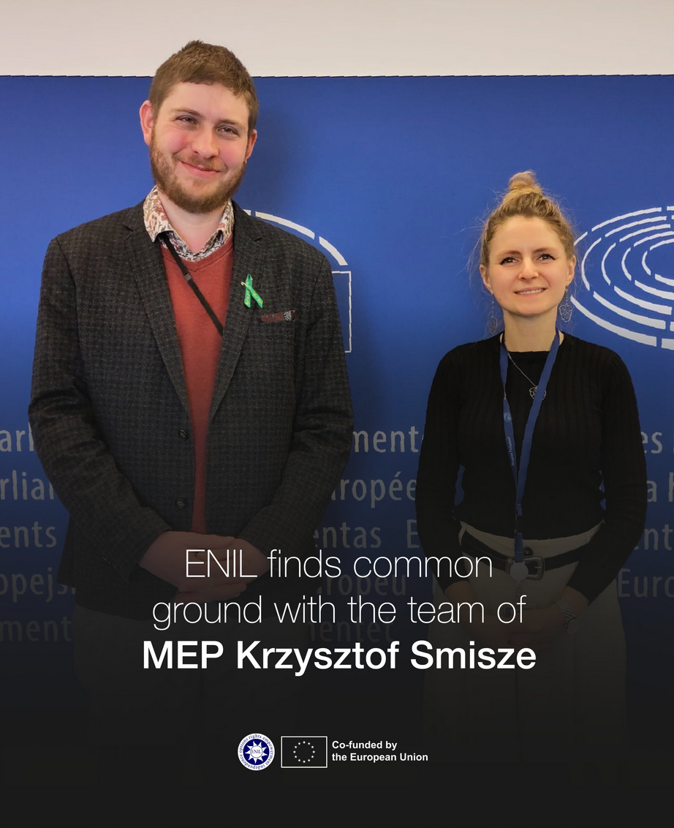
Advocacy work: We send our lobbyists
ND Policy Poordinator

Slide 23
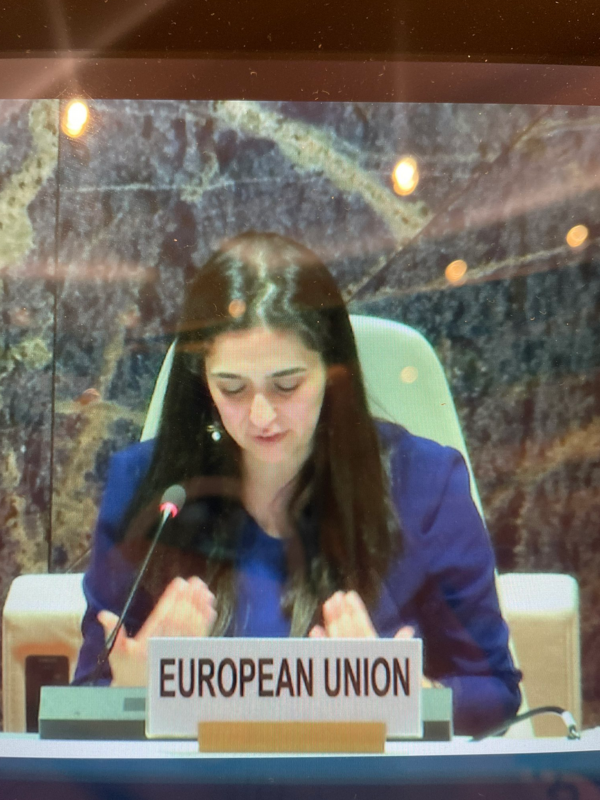
Advocacy work: We send our lobbyists

Slide 24
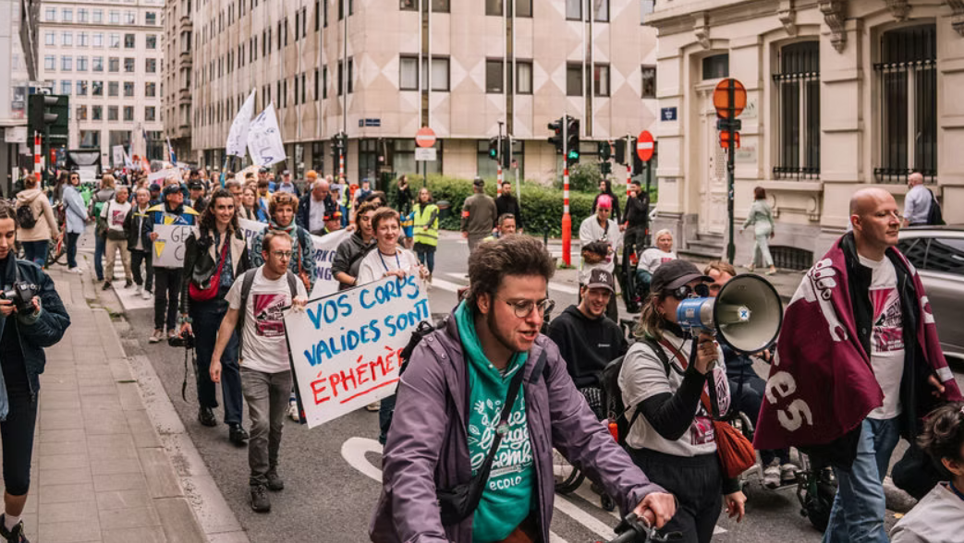
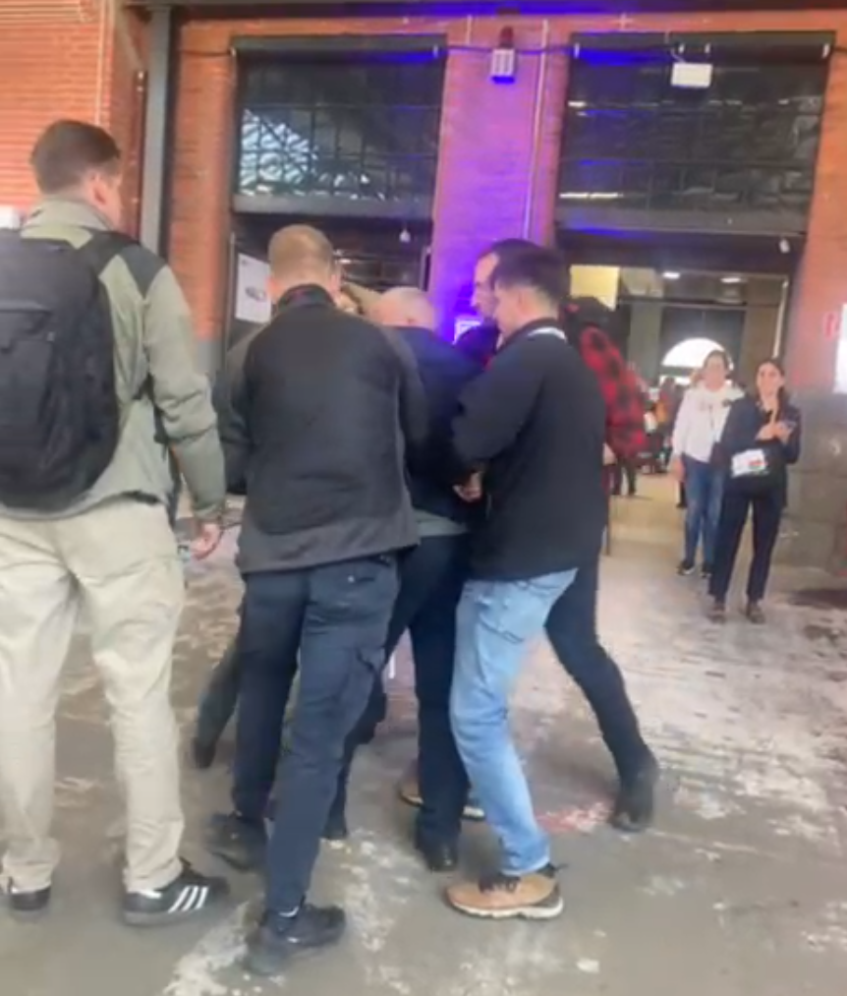
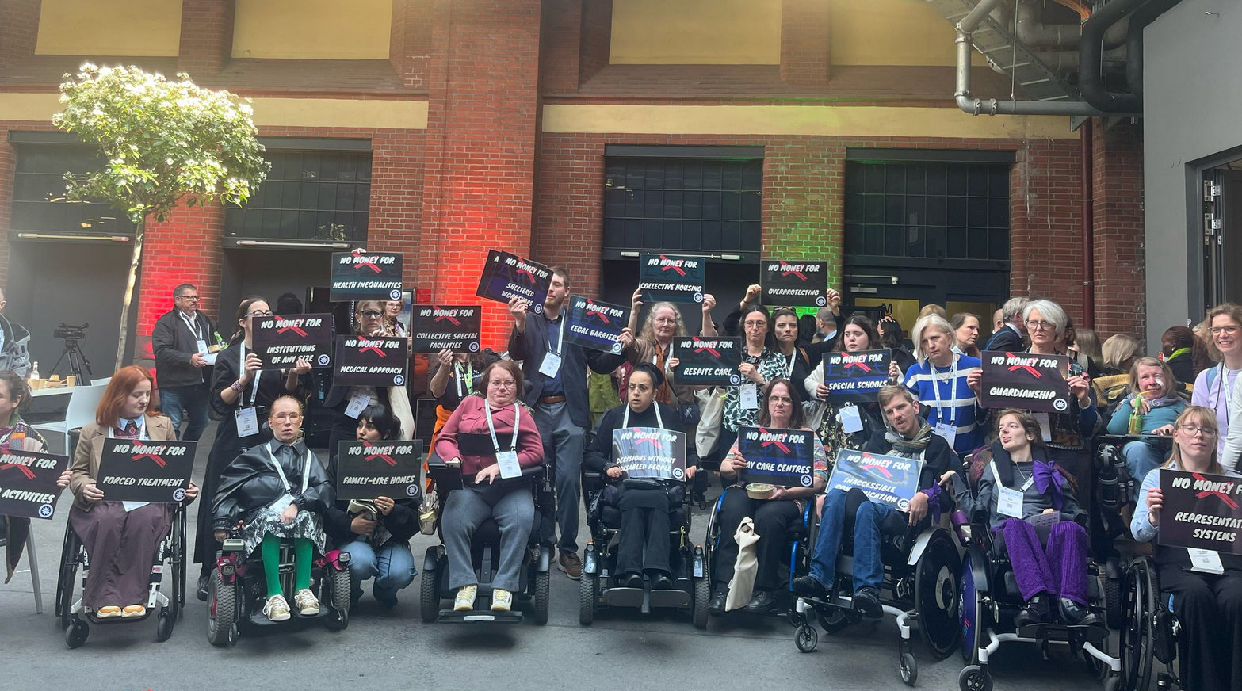
2. Protest: We are many

Slide 25
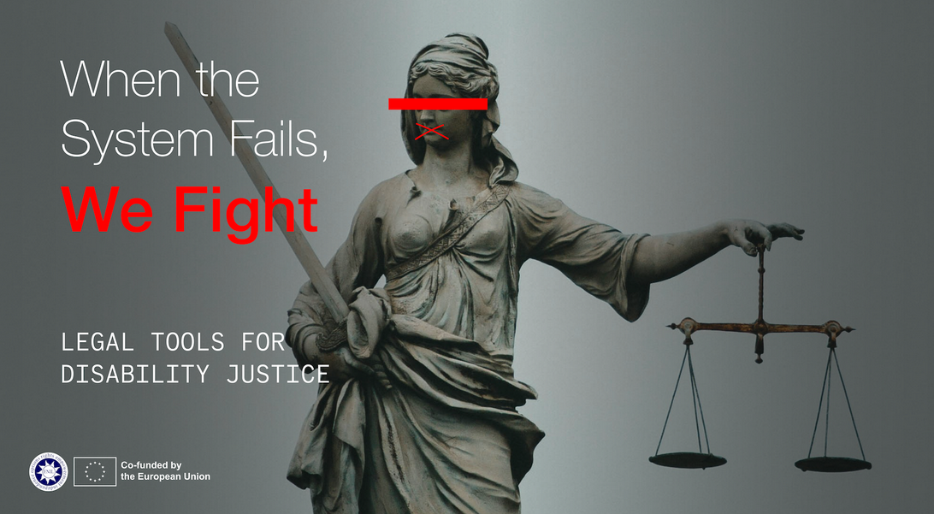
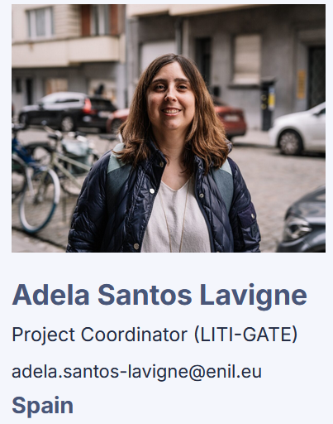
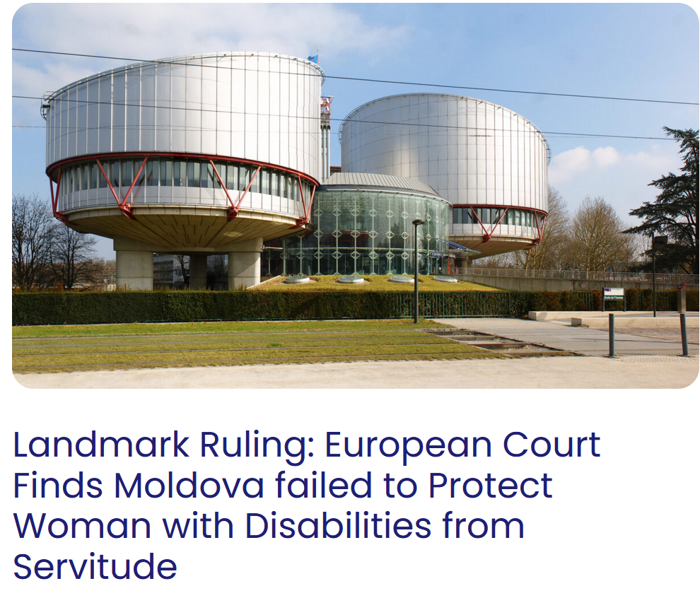
3. Litigation: We have lawyers
ND Lawyer

Slide 26
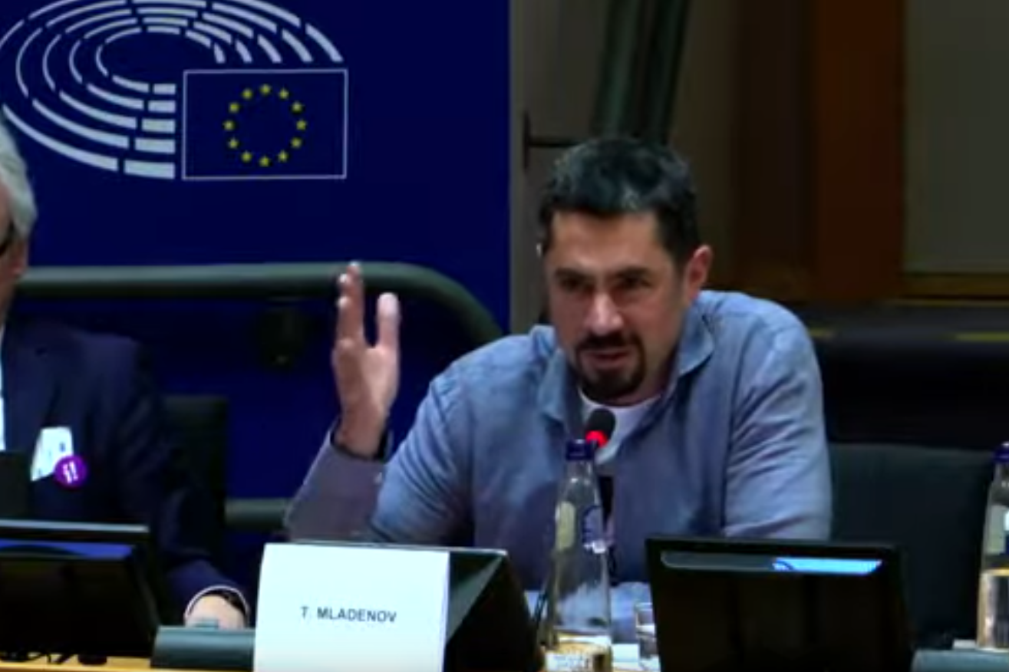
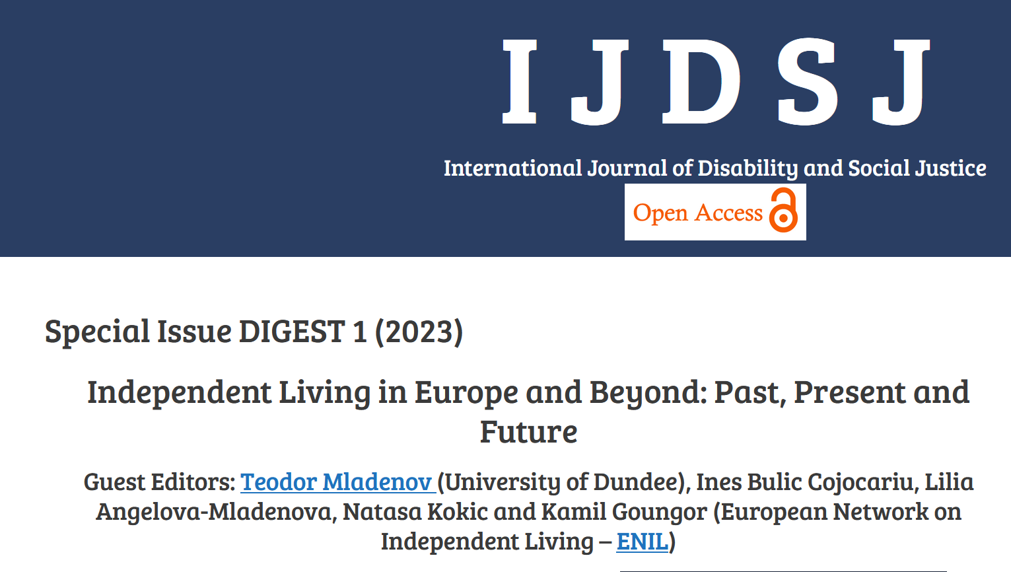
4. Knowledge and awareness: We have researchers

Slide 27
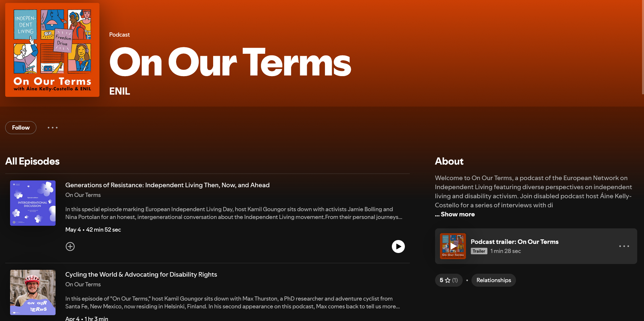
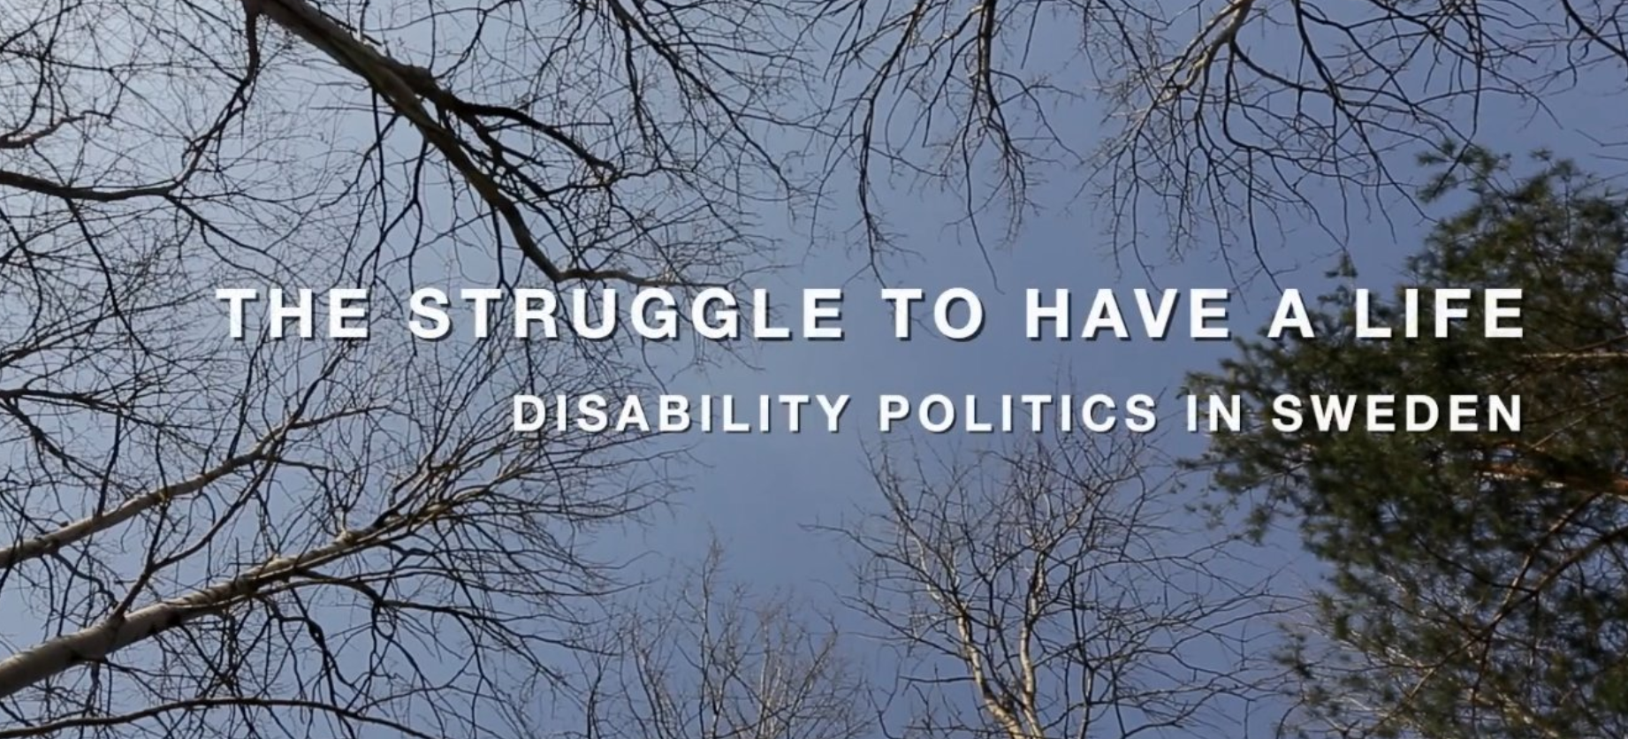
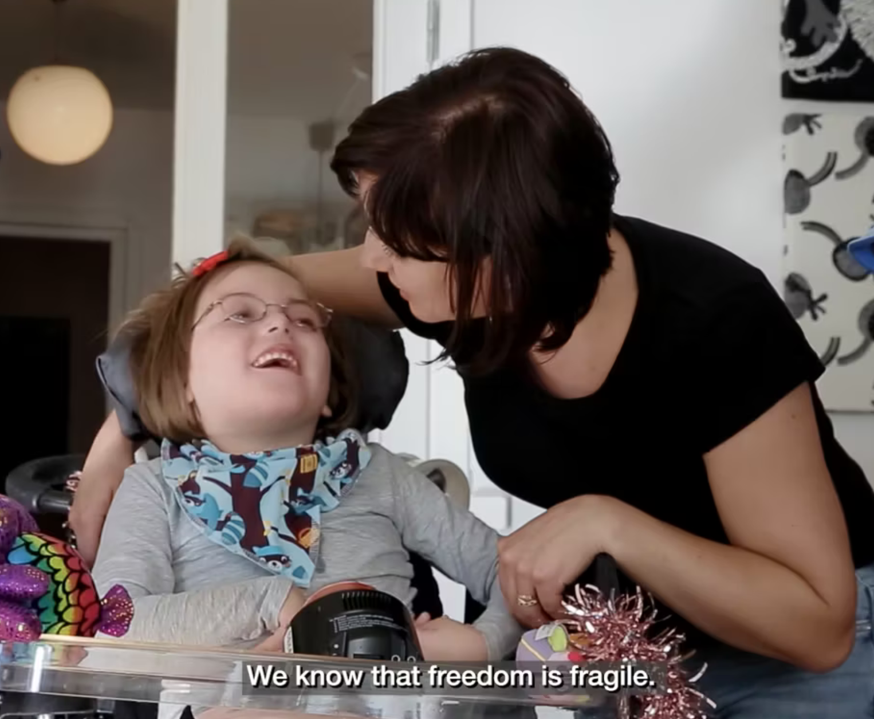
5. Awareness raising: We make people look

Slide 28
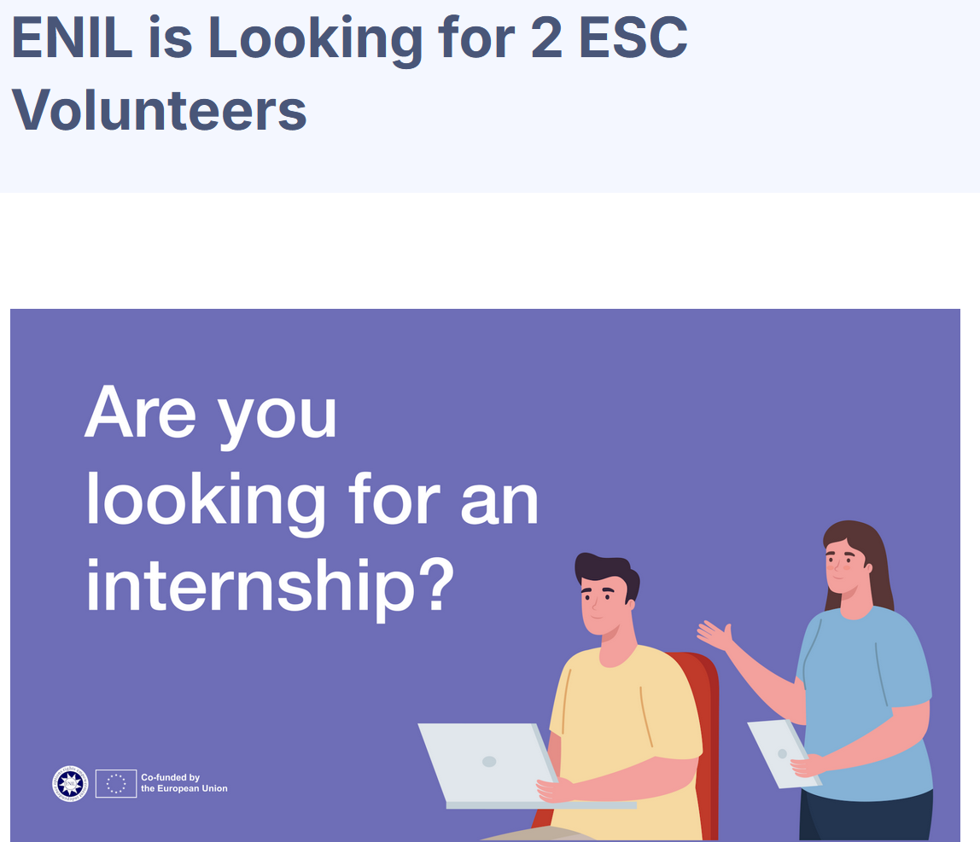
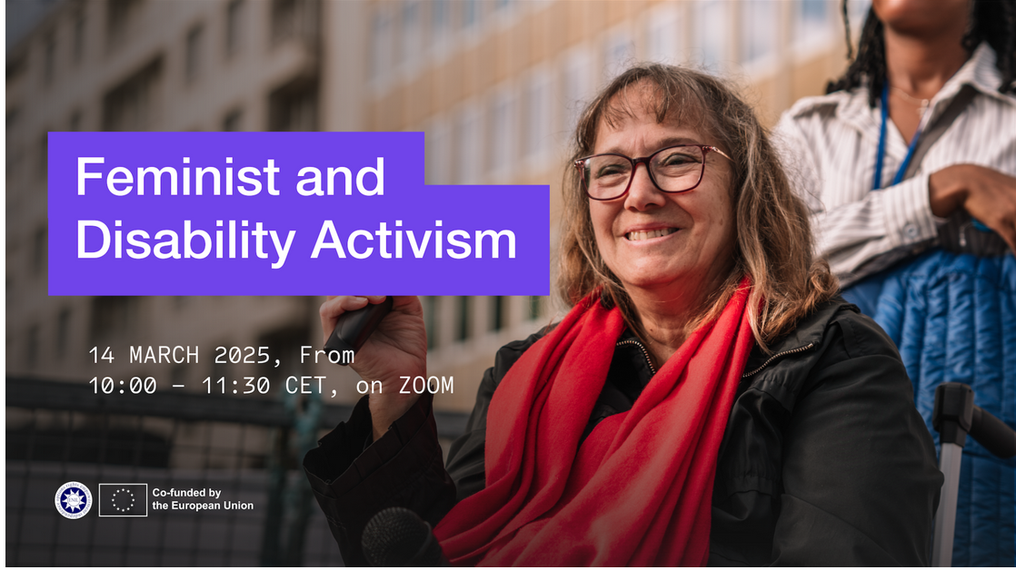
6. Empowerment

Slide 29
Key facts
Principles of Independent Living (guiding document)
The Independent Living Movement must be a cross disability movement addressing the needs of all disabled persons
1000+ individual and 1000+ organisational members (including associations of associations)
Overlap with Neurodiversity Movement
Individual members
Organisations
European Council of Autistic People

Slide 30
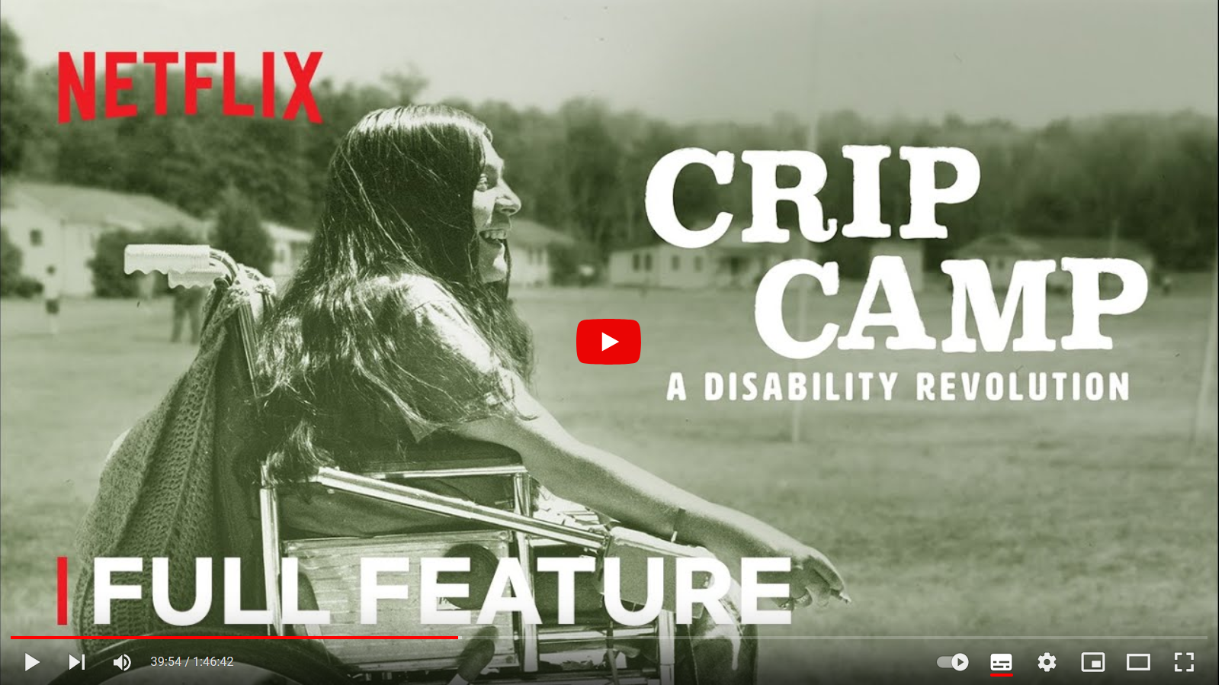
Key facts
Part of a worldwide movement that originated in the US
World Independent Living Network

Slide 31
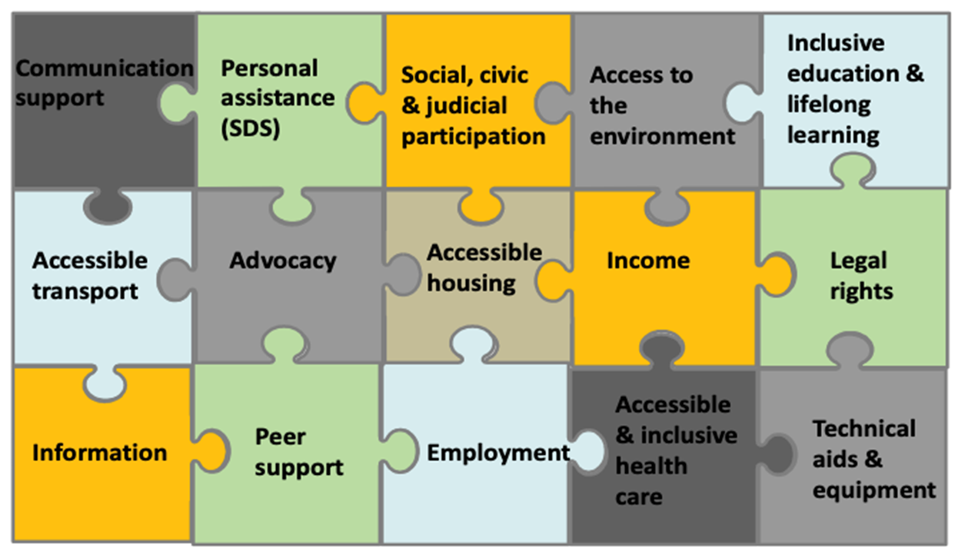
15 Pillars of Independent Living

Slide 32
Example of advocacy action
Objective: Improving access to employment
Available instruments
The employers side
Antidiscrimination legislation
The employees side
Sheltered employment
Supported employment

Slide 33
How to support disabled employees?
Sheltered employment
For example sheltered workshops
Supported employment
Accommodations (More time for tasks, lower workload, working from home)
Personal assistance at work (Help with controlling stimuli, remaining focused and emotionally balanced)

Slide 34
Distribution of funding
Subsidies to sheltered employment
Sweden: EUR 500 Mio per year to Samhall
Belgium: EUR 30 Mio until 2030 to create 1000 additional places
Czech Republic: EUR 373,4 Mio in 2021

Slide 35
Reforming EU State Aid Legislation
What is state aid?
Subsidies paid by national authorities to companies or organisations if they threaten to disturb competition
Exclusive EU competence
EU can monitor, legislate, enforce

Slide 36
General Block Exemption Regulation
Part of state aid regulatory landscape
List of products of services that can be subsidised
Includes: “Aid for disadvantaged workers and for workers with disabilities”
Support to pay wages (to compensate accommodations)
Work assistance
Purchasing equipment
Adjusting premises (renovations)
Rehabilitation
Transport
Sheltered employment

Slide 37
General Block Exemption Regulation
Proposal: Remove Article 34(2)(f)
Support to pay wages
Work assistance
Purchasing equipment
Adjusting premises (renovations)
Rehabilitation
Transport
Sheltered employment
(f) where the beneficiary provides sheltered employment, the costs of constructing, installing or modernising the production units of the undertaking concerned, and any costs of administration and transport, provided that such costs result directly from the employment of workers with disabilities.

Slide 38
Why is sheltered employment bad?
Prevents rather than supports labour market inclusion
Exploitative
Creates shortage of funding for effective instruments
Not in line with UN CRPD

Slide 39
Starting an advocacy campaign
1. Providing evidence
Reports in 2023, 2024 and 2025 (coming up)

Slide 40
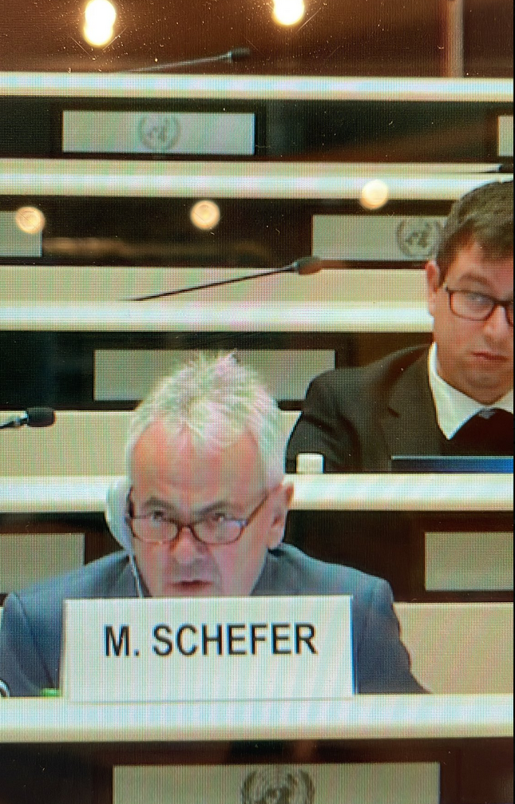
Starting an advocacy campaign
2. Getting the UN on board (done)
Decision of the UN Committee on the Rights of Persons with Disabilities:
“The Committee recommends that the European Union: (a) Repeal legislation that allows public financing of segregated forms of employment for persons with disabilities, such as institutions and other segregated facilities … repeal article 34(2)(f) of the General Block Exemption Regulation … and prohibit State aid of segregated employment.”

Slide 41
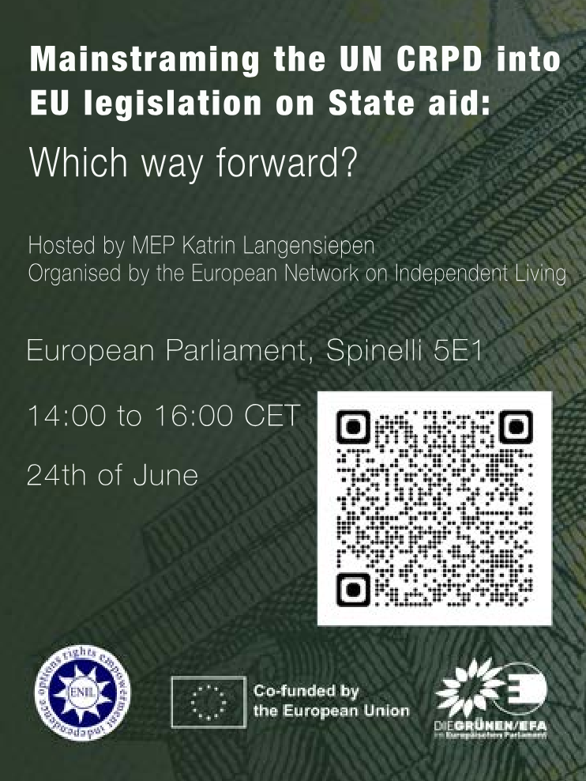
Starting an advocacy campaign
3. Organising events involving stakeholders (to be completed soon)
Members of the European Parliament
European Commission
Maltese governments
European Disability Forum, Inclusion Europe

Slide 42
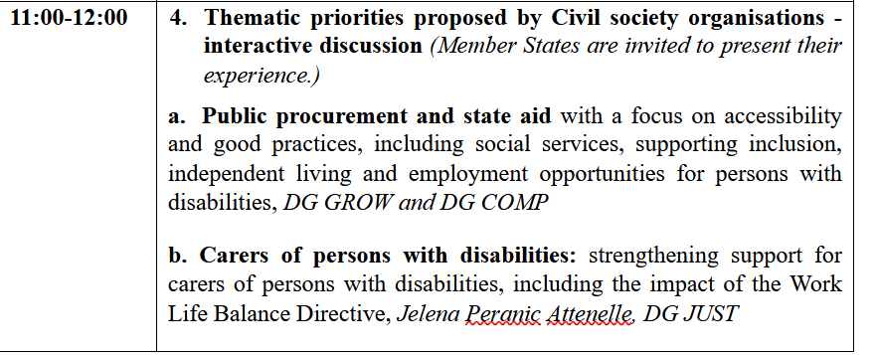
Starting an advocacy campaign
4. Setting the agenda of the next DP (done)

Slide 43
Starting an advocacy campaign
5. Building an advocacy coalition (in progress)

Slide 44
Starting an advocacy campaign
6. Our input to the European Disability Strategy part II
In progress...

Slide 45
Starting an advocacy campaign
7. Our input to our Recommendations to the Danish EU Council Presidency
In progress...

Slide 46
Starting an advocacy campaign
8. ...
I am not sure yet
Frequent question for a lobbyist:
WTF am I going to do next?

Slide 47
Thank you for listening!
More information:
https://enil.eu/
florian.sanden@enil.eu

